Slide 1

COLLEGE INFORMATION BANK
One stop place for college selection
V. Harshita 1602-20-737-134
D.Lakshmi Bhavani 1602-20-727-141
K. Nidish 1602-20-737-147
This Photo by Unknown Author is licensed under CC BY-SA
Notes:
NOTE:
To change the image on this slide, select the picture and delete it. Then click the Pictures icon in the placeholder to insert your own image.

Slide 2
PROBLEM STATEMENT
All India Council for Technical Education (AICTE).
There are more than 1000 universities in India and these universities are offering thousands of undergraduate, post-Graduate and doctorate courses. The students applying for these universities have to do a lot of comparison for choosing the university/course on the basis of various criteria’s. A PAN India university information bank is required for accessing course details, comparison of courses, facilities and faculty, admission, tracking student mobility, viewing results, evaluation and certification, verification of certificates, joint online courses (MOOCs). This will help both student and faculty communities for self improvement through comparison and emulations. Lack of information is leading to self glorification and inbreeding among University and College student and faculty members.

Slide 3
ABSTRACT
Integrated information platform for information about Indian Universities
The universities in India provide various courses on different disciplines and the students have to compare these courses on the basis of various parameters. The courses range from Bachelor, Masters and P.hd courses. The integration of these details on a single platform will enhance the transparency and remove difficulty being faced by the students due to lack of information

Slide 4



FEATURES
Compare selected colleges
Sorting of colleges based on NIRF Rankings, Average package
Google maps API to find college Location

Slide 5
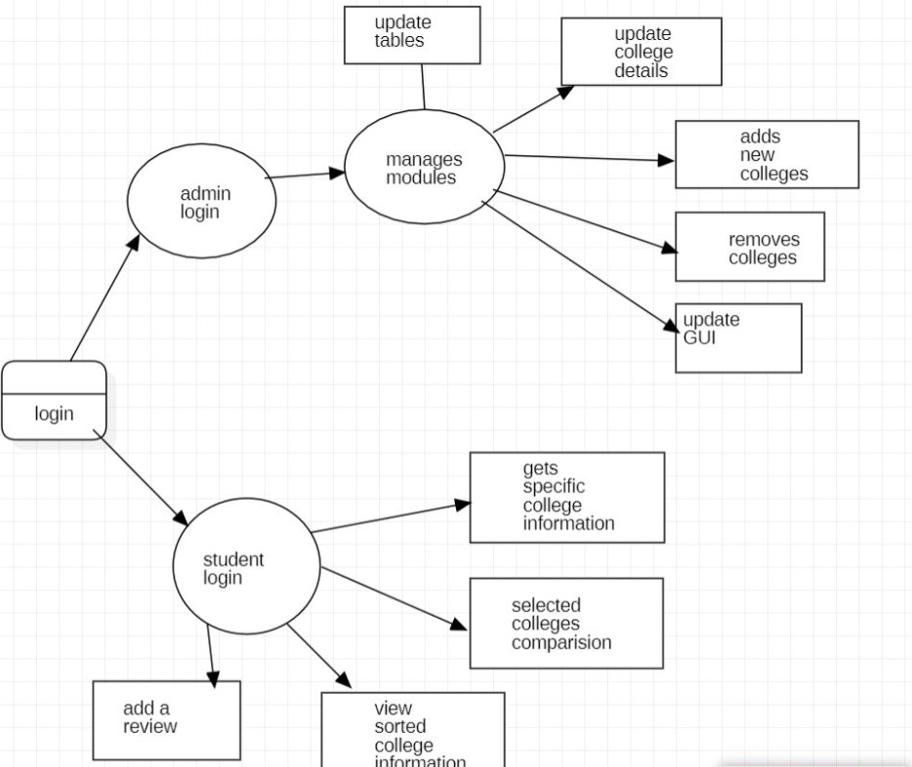
DATA FLOW DIAGRAM

Slide 6
IDEA / APPROCH DETAILS
DESCRIPTION
A WEB Application which helps students gather information.
Helps students to choose the best college
To save Time and Efforts of students spent in Decision Making.
To help students not to fall prey of information/misinformation.
TECHNOLOGY USED
TEXT EDITOR: VISUALSTUDIO CODE
Front end:
HTML(to create the structure of the website)
CSS(Cascading Style Sheets to style and web Layout)
JAVASCRIPT(to make page Responsive)
Back end:
EXPRESS JS(to make a single page or multipage web app)
NODE JS(to handle huge I/O operations)

Slide 7
DEPENDENCIES: HeaVY DATABASE TO Collect authentic information about colleges and their accreditions.

Slide 8
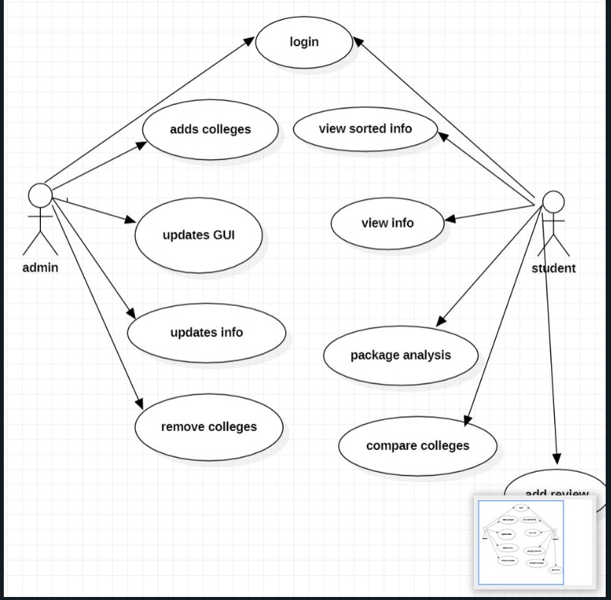
USECASE:

Slide 9
USE CASE 1:-
Use Case Name:-College Information
Actors:-User , System
Description:- To get the information about college which user want to know
Pre Condition:- College Selection
Post Condition:-Getting information about college by clicking
USER | SYSTEM
 | 1.List of colleges displayed
2.User clicks on the desirable college | 3.College information is Displayed

Slide 10
USE CASE 2:-
To Sort the colleges according to the rating or by the average salary .
Use Case Name:-College Information
Actors:-User , System
Description:- To sort the selected colleges
Pre Condition:- College Selection
Post Condition:-Getting information about college by clicking
USER | SYSTEM
1.Select desired colleges by checkbox
 | 2.Sorting according to salary
 | 3.Order is Displayed

Slide 11
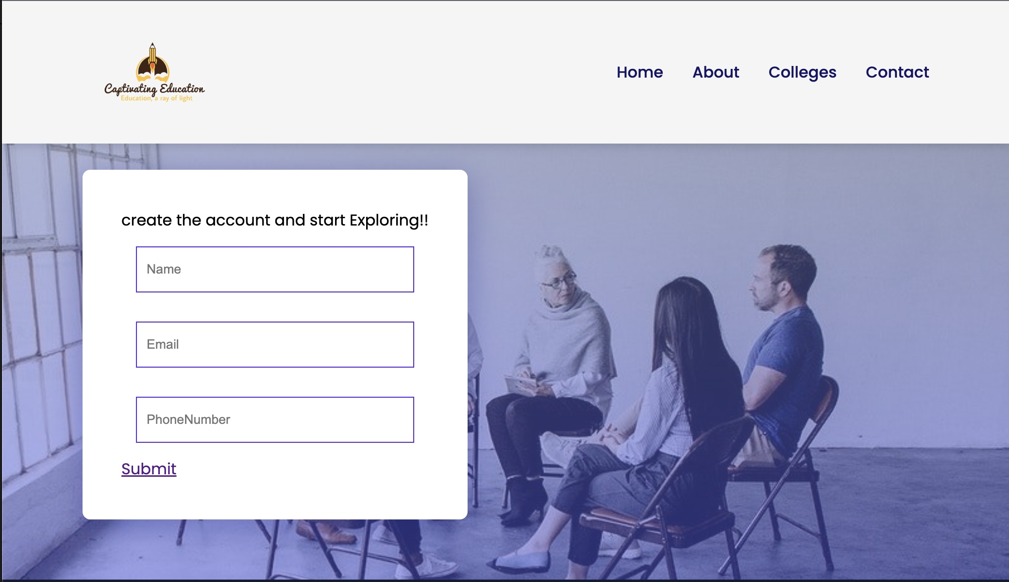
Login/Register:-

Slide 12

OUTPUTS:-
Home Page:-

Slide 13
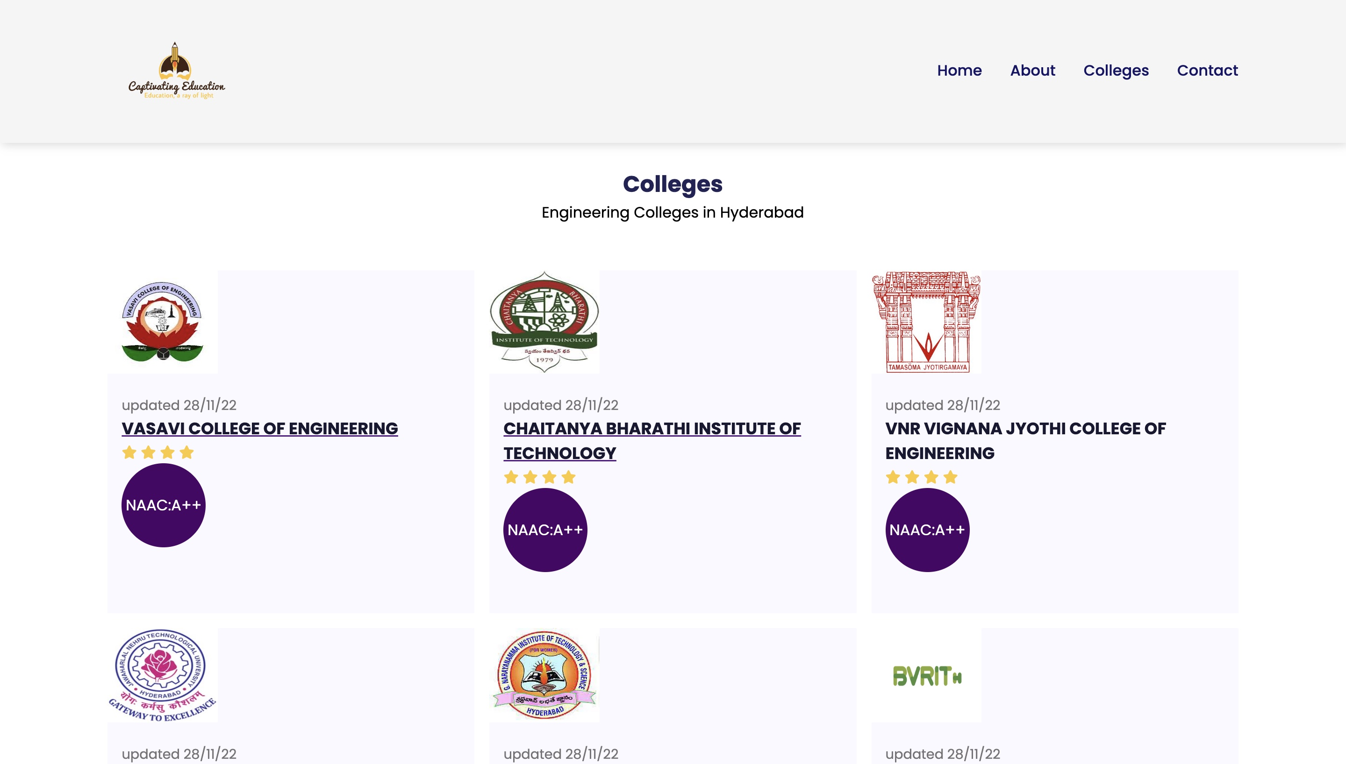
List Of Colleges:-

Slide 14
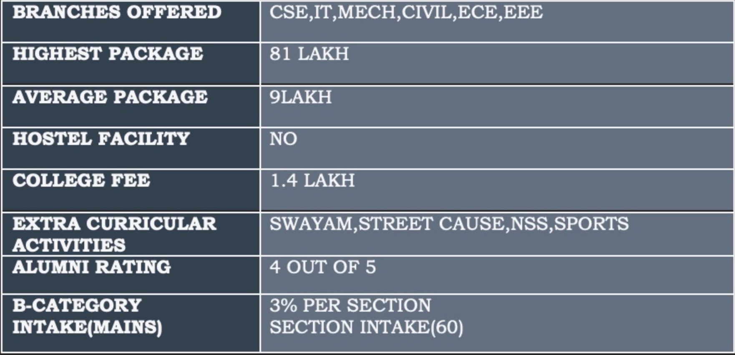
College Information Display Format:-

Slide 15
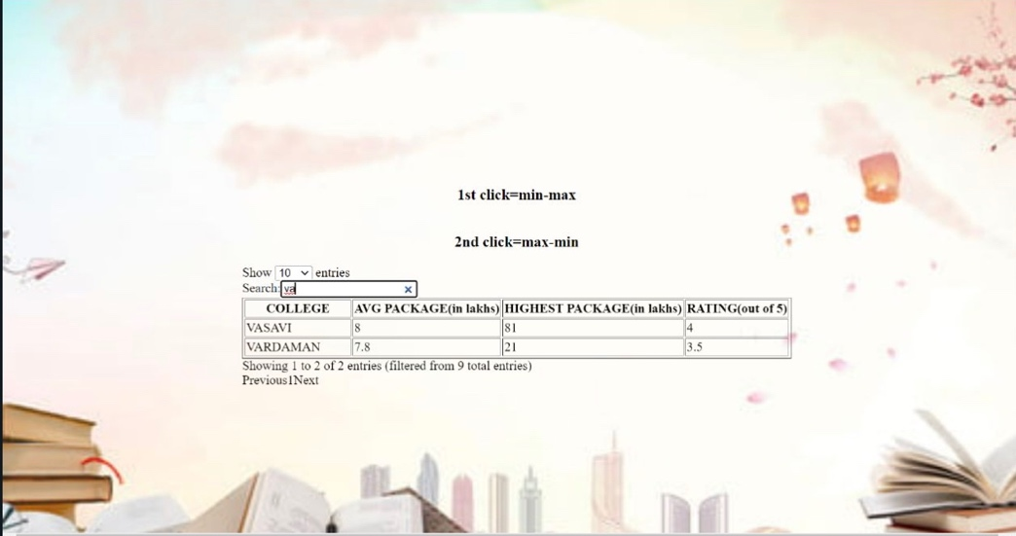
SEARCHING

Slide 16
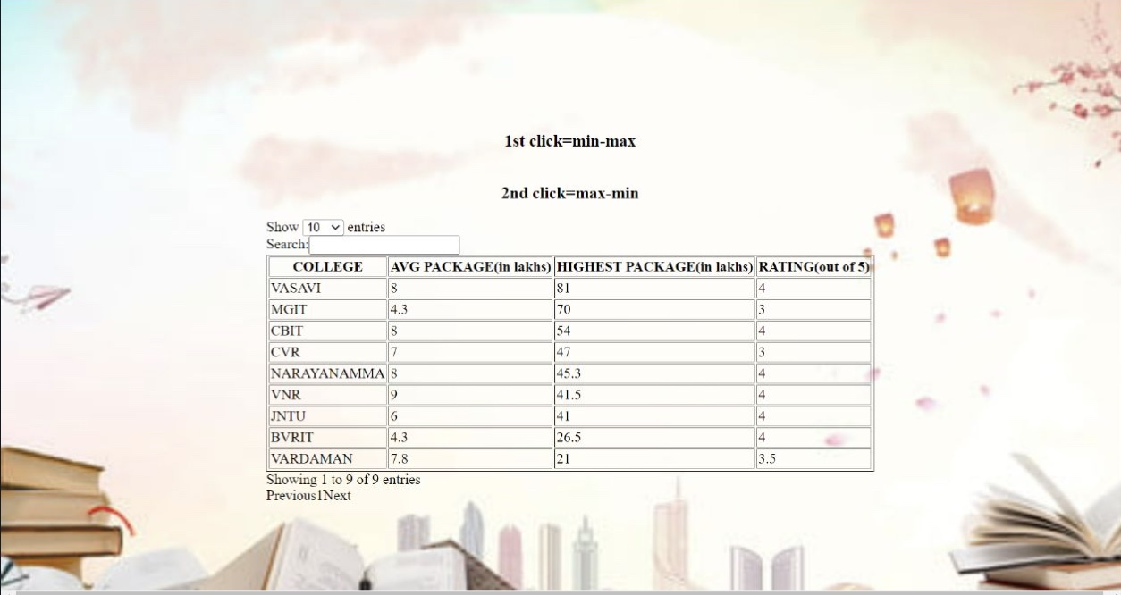
SORTING

Slide 17
Future Scope:
To make the website Available for wide Range of
Colleges.
To Enable the users interact with the Alumni of the
Respective Colleges.
To submit the b-cat applications by filling the form only once and by clicking on the colleges into which the user want to join rather than filling the same details multiple times.SSS

Slide 18
REFERENCES
https://youtu.be/RamIl-pjGE4
https://youtu.be/QwrCPOO4LDc
https://youtu.be/eJcOHPkPiZg
https://www.javatpoint.com/how-to-sort-table-data-in-html-using-javascript

Slide 19



